Slide 1
The NET AI Stack
Building AI Enabled Systems on .NET
Mike Yeager
CEO CODE Consulting

Slide 2

Mike Yeager
CEO CODE Consulting
Senior developer and manager
AI project lead
Writer & speaker
MS Azure contributor
myeager@codegroup.io

Slide 3






Slide 4






About CODE Consulting
Custom software development
(web, mobile, desktop and cloud platform apps)
Copilot development, AI, GPT, Azure OpenAI,
machine learning, and more…
Project rescue (cloud, web, mobile, Windows, …)
App modernization (primarily Visual FoxPro)
Support & maintenance for existing applications

Slide 5
Agenda
What are agents, and why do I care?
What is Microsoft.Extensions.AI?
What is Microsoft.Agents.AI?
Who are Agent Framework’s competitors?
When do I choose it?
How do I use it?
Q & A

Slide 6
What are Agents Anyway?
Agents have goals
Agents autonomously pursue goals (tasks are handed off to agents)
Agents can be given:
  Tools
  Memory
  Reasoning/Deep Reasoning
  Planning/Orchestration/Workflows
Agents can have sub-agents
Specialized Agents can be more effective than a single, generalized chat session

Slide 7
Agent Fwk - Why do I care
Coding to specific APIs locks you in
Different providers (both cloud and local) provide different feature sets
You have to learn different APIs for different tasks
It’s tedious to write low level code for things like streaming responses or maintaining chat history
You can use things like caching and telemetry fairly easily

Slide 8
Builds on Microsoft.Extensions.AI
Abstractions (IChatClient, IImageGenrator, IEmbeddingGenerator)
Mid-level, provider agnostic libraries for coding AI tasks
Provider Implementations for:
  Text Completion & Chat
  Image Generation
  Embeddings (semantic search / RAG)
  Tool Calling
Add-Ons:
  Model Context Protocol (MCP) (client via NuGet pkg)
  Orchestration & Workflows
  Caching / Memory / Sessions
  Telemetry / Observability / Middleware

Slide 9
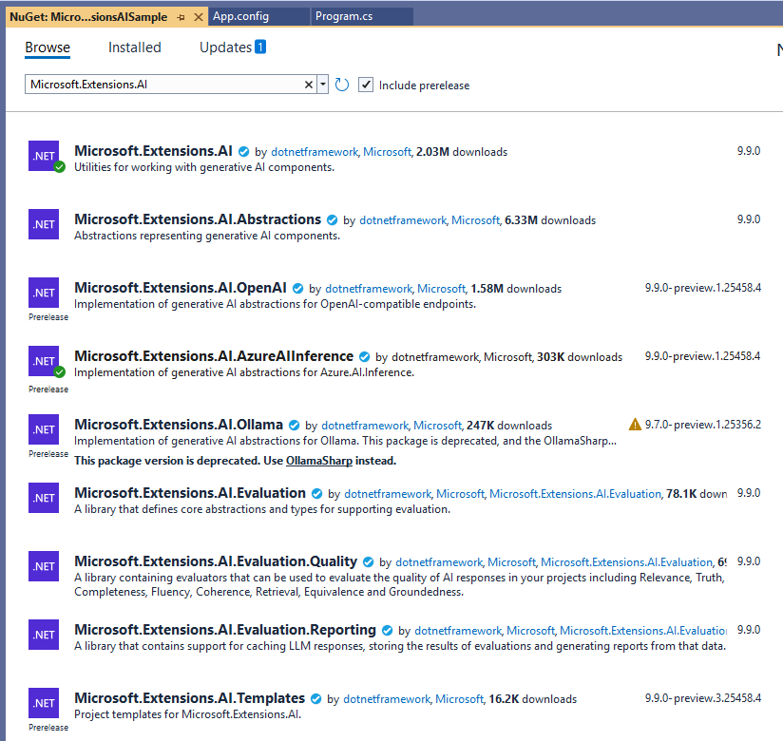
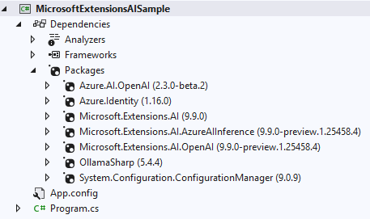
Microsoft.Extensions.AI NuGet

Slide 10





Which providers does it support?
Open AI
Azure Open AI
Azure Foundry Models
Ollama
Create your own provider
  Anything using the Open AI protocol
  Phi Silica
  Onyx

Slide 11
What is Microsoft.Agents.AI?
Successor to Semantic Kernel and AutoGen (High Level)
  Implements abstractions & providers in Microsoft.Extensions.AI
  .NET and Python
  Structured output
  Workflows
  Background responses (long running workflows)
When available:
  Code interpreters
  File search
  Integrations (M365, Azure Functions, A2A Hosting, Dev UI, Purview, etc.)

Slide 12
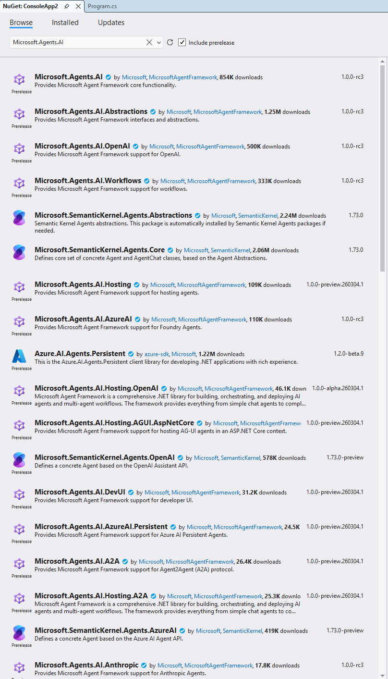
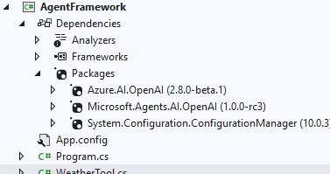
NuGet Packages

Slide 13
Competitors
LangGraph
  State machine workflows
  Builds on LangChain
  Python and JavaScript

Slide 14
When do I choose it?
Low-Level: Writing directly to provider specific APIs and SDKs may be a good choice if you’re locked-in to a provider and want low-level control
Mid-Level: Using Microsoft.Extensions.AI may be a good choice for light weight, composable, abstract coding
High-Level: Using a high-level framework like Agent Framework may be a good choice for higher level tasks like building agent frameworks, doing orchestration, long running, complex tasks

Slide 15
How do I use it?
AIAgent
AgentSession
AgentResponse
OpenTelemetry, Logging, Caching, Chat History, Dependency Injection, Builders, etc.

Slide 16
Demo

Slide 17



Free Subscription
The leading software development magazine,
written by expert developers for developers.
All registered attendees will receive a
free digital subscription to CODE Magazine!
Share this link to our free subscription:
bit.ly/CP1025Subscribe

Slide 18

Please take the survey
bit.ly/CP1025Survey

Slide 19

AI Executive Briefings
Check out our new Executive Briefing offer!
We can help with your AI needs
What does AI mean for you?
codemag.com/AI
codemag.com/ExecutiveBriefing

Slide 20

CODE Staffing
Disrupting the world of staffing!
Giving our customers the ability to have
staff on par with Silicon Valley companies …
… and our employees a work environment
in a bleeding-edge tech company with
the industry leading benefits!
codestaffing.com

Slide 21

WE NEED YOU!
codestaffing.com/careers

Slide 22

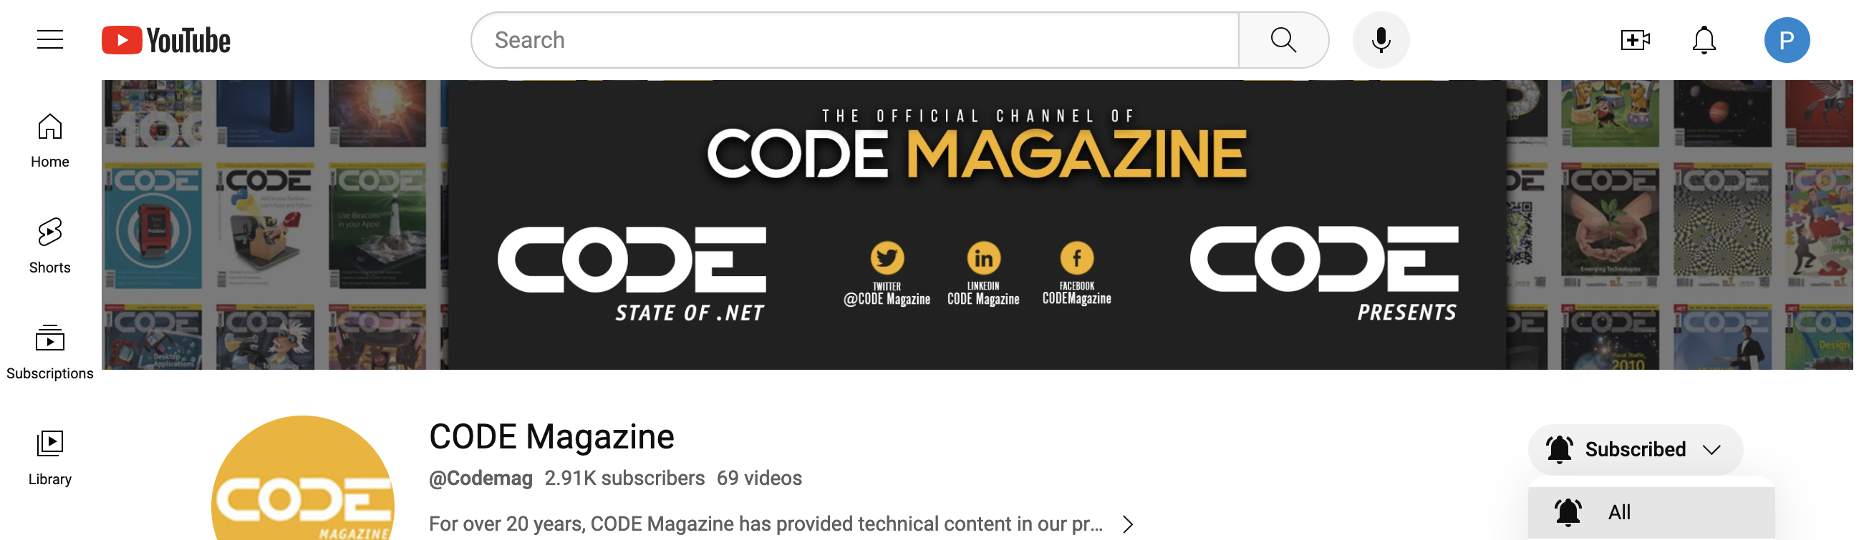
Subscribe and “ring that bell”
to never miss any of our content!
youtube.com/codemag

Slide 23
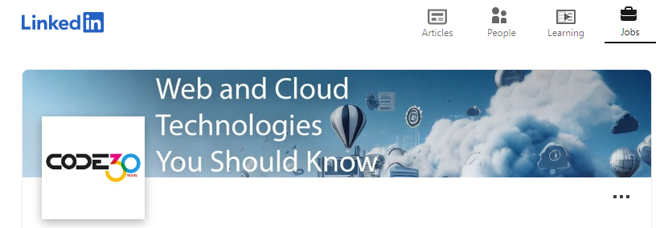

Be the first to know about our webinars, workshops, and live events!
Follow us!
www.linkedin.com/company/code-magazine

Slide 24
Q&A
Contact us with questions!
CODE Contact
codemag.com
info@codemag.com
facebook.com/codemag
twitter.com/codemagazine
Presenter Contact
myeager@codegroup.io

